Slide 1
BSA Basketball Research Proposal
Nadeev Alam, Kiersten Roth, Harsh Govindji, Siddharth Singh, Andrew Weiner, Divik Chotani

Slide 2
Agenda
Research Question
Data
Types of Models
Technologies / Languages
Deliverable

Slide 3
Research Question
Can we predict the probability of a shot being made based on player behavior and situational factors such as defender proximity, shot clock timing, and dribble count? Are "bad" shots for most players still good shots for elite shooters?

Slide 4
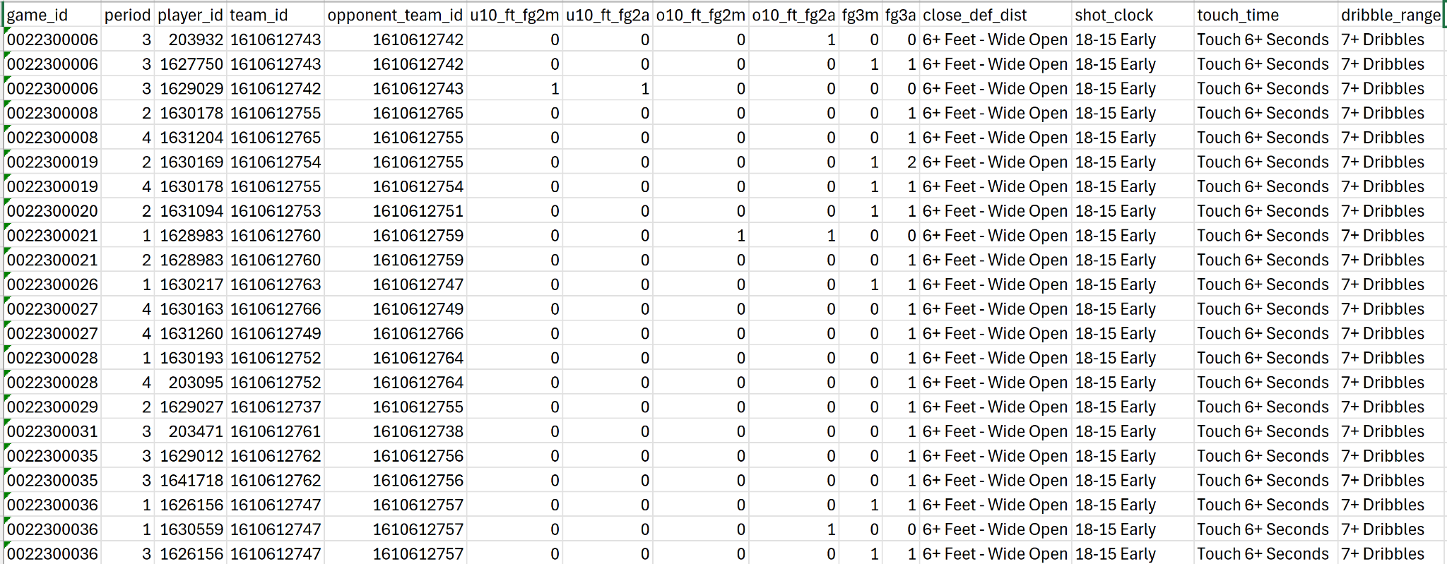
Datasets
Shot-tracking Data
Player Career Stats - nba.com
SS From Shot Tracking Data

Slide 5
Models / Languages
K-Means to categorize players
Logistic Regression to come up with shot probability
Possibly use Pytorch to create a nn model using ReLU and Softmax activation functions to output a probability of success.
Explore other models if necessary
Languages
Python for visualization & model implementation
R for model selection and validation

Slide 6
Methodology / Deliverables
Cleaned Data
Classifying players archetypes (i.e. paint scorer, 3pt specialist, midrange shooter)
Two Models
One with each player as an individual factor
One with player archetype as a factor
Model selection
Recommendation

